Slide 1

S.T.A.R. Curriculum
Refresher
Adapted from Joel Arick, John Gill, and Holly Klein
by
Mikhailah Brace

Slide 2
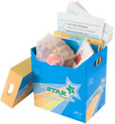
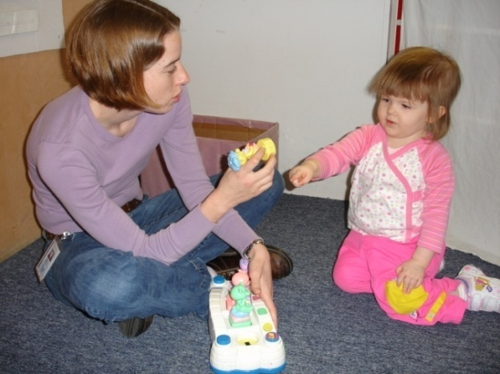
S.T.A.R. Curriculum Refresher
8:00 Introductions
8:30 STAR Overview/Explore Materials
9:45 Break
10:00 Student Learning Profiles (SLP)
10:45 Functional Routine (FR) Review
11:30 Lunch
12:15 Discrete Trial Review
1:45 Break
2:00 Pivotal Response Training (PRT) Review
3:15 Organize Materials
3:45 Wrap Up
4:00 Finished ☺

Slide 3
Complete the
Student Learning Profile (SLP)
Fill out the SLP for the child
Each curriculum area (column) of the SLP is independent
Complete the Level I, II and III profile as needed until you find the student’s level in each curriculum area
Using the Program Guide of the SLP put a check mark beside each Lesson that is mastered and circle each lesson that needs to be taught
18

Slide 4
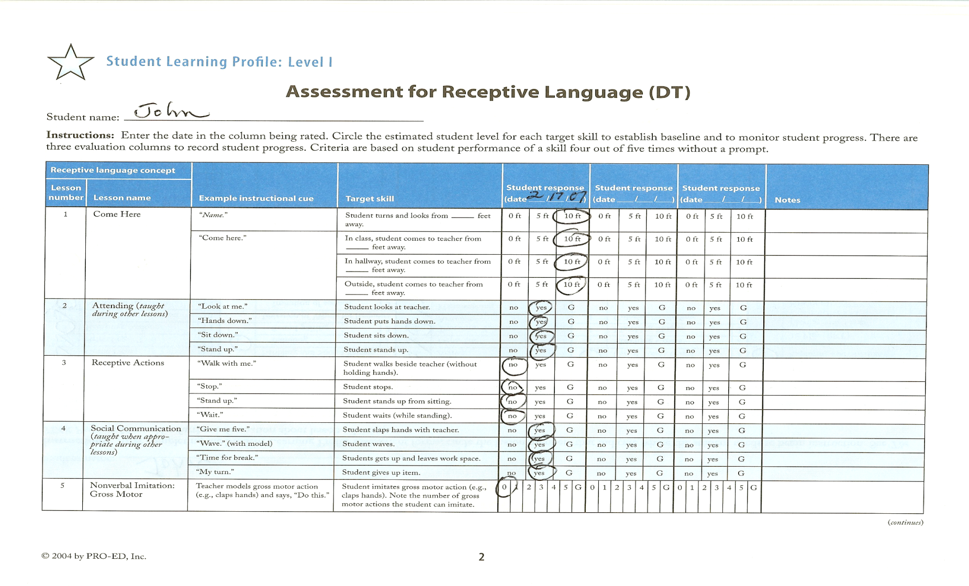
Use Student Learning Profile
To Conduct Assessment
4

Slide 5
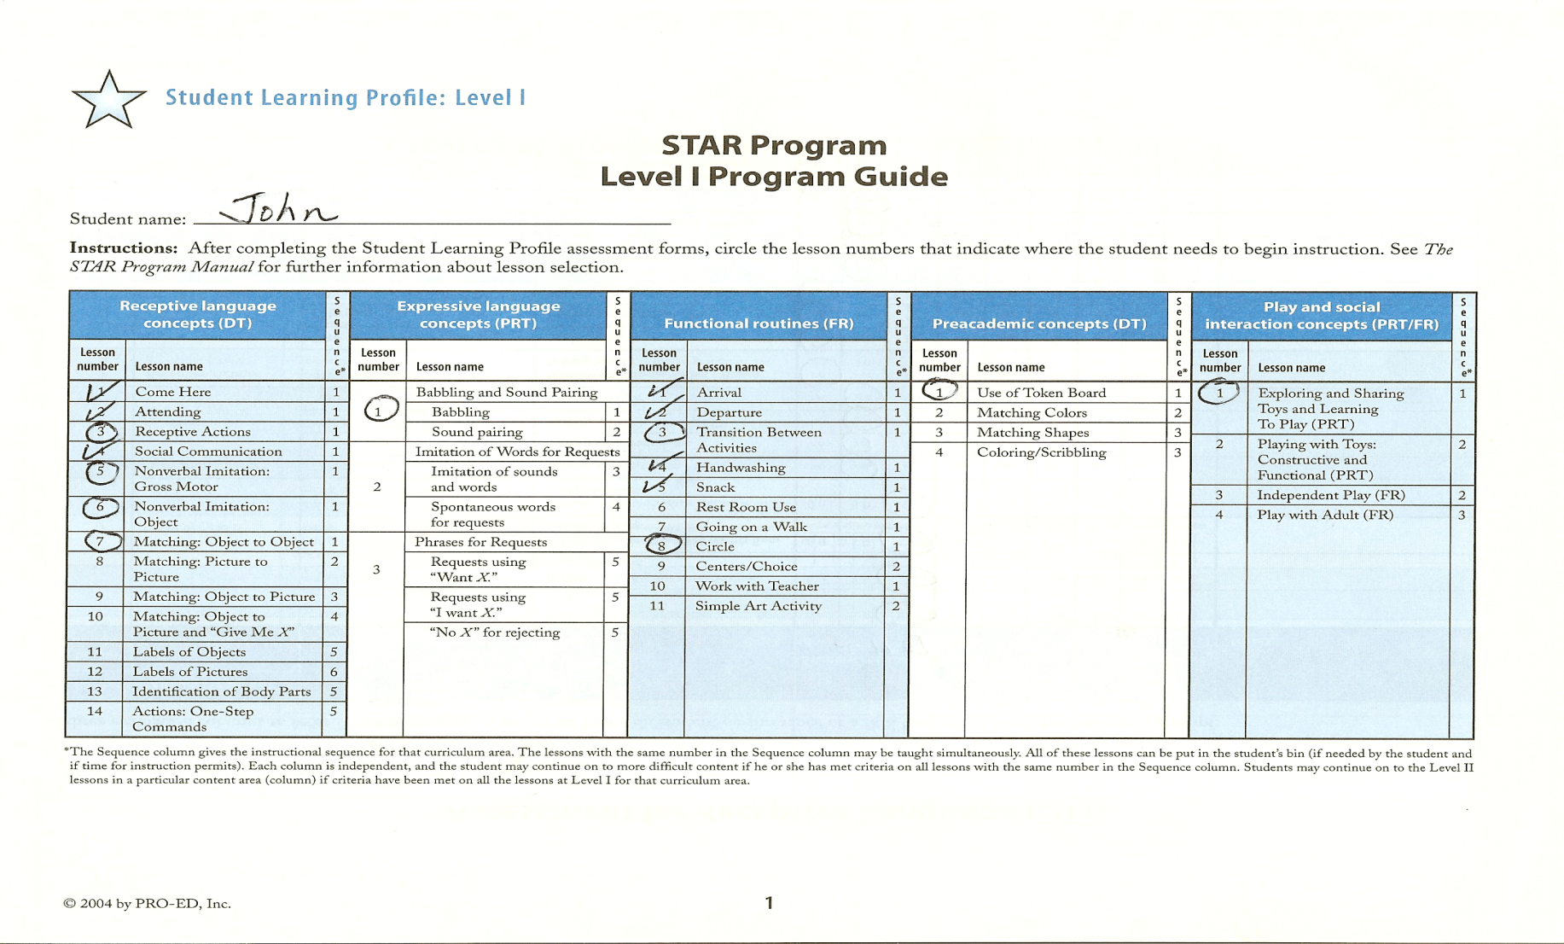
Use Learning Guide to Identify Programs to Teach
5

Slide 6
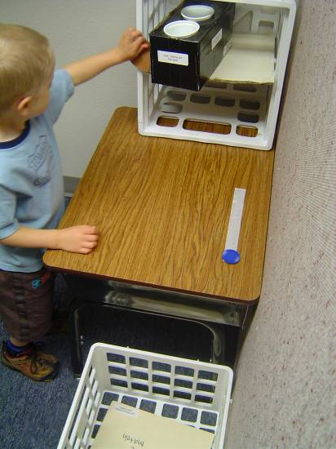
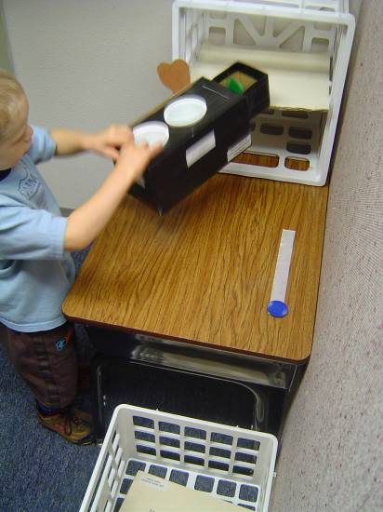
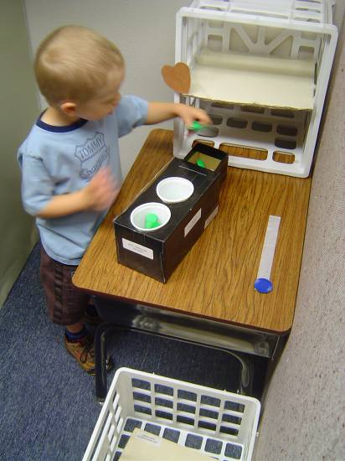
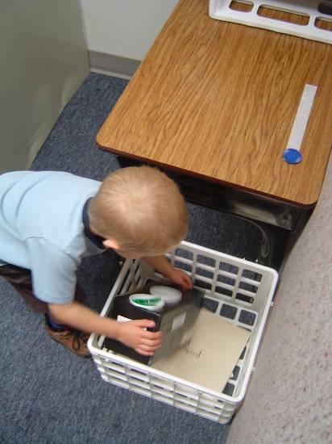
Correct Response
Functional Routines

Slide 7
Identify Appropriate Routines
Use the STAR student learning profile to determine where to start
If child requires prompting to correctly perform some or many of the target activities of the routine,
and
team members identify routine as a priority.
If child requires prompting to correctly perform most or all of the target activities of the routine,
and
team members identify the routine as a current priority.
If child correctly completes most target activities of the routine without prompting,
or
team members do not identify the routine as a current priority.
Select a different routine at the same level or select a routine at the next level.
Select this routine and consider other routines at this level.
Consider a similar routine from a lower level.
5

Slide 8
Independence Measurement Scale
(also used for prompt levels)
4 = No added prompts (independent)
3 = Verbal or gesture prompts
2 = Physical prompt for part
1 = Physical prompt for all or most
0 = No response
n/a = Not applicable
8

Slide 9
Review Environment/Develop Supports and Adaptations for Independence
Problem: Children with autism have difficulty discriminating relevant/irrelevant stimuli and these students may benefit from visual-spatial supports to clarify/augment natural cues
Goal: Develop systems that can eventually be self-managed and used throughout life
Solution: Create and use environmental supports such as visual schedules
12

Slide 10
Identify Target Skills for Incidental Teaching
When a student has mastered skills taught in isolation, then he/she is ready to generalize the skill across different areas, materials, or people.
Be deliberate about teaching generalization of acquired skills
  Circle time
  Snack
  Choice time
  Recess
  Daily routines
34

Slide 11
Plan Teaching Methods
Incorporate the DT and PRT strategies where appropriate if, for example, a child is struggling with his/her schedule, needs to be taught the hand washing routine, or is not generalizing a skill.
Break learning up into small, achievable steps.
Task analysis
Forward/Backward chaining
Shaping
35

Slide 12
Organization of Materials
Organize materials for routines
  Predictable locations
  Teach children to obtain items and return to project
    Initial level – order materials top to bottom or left to right
    Mid-level – use visual organizers (templates/containers)
    Advanced level – teach child to organize materials
16

Slide 13
Organization of Events in Time
  Prerequisite: Develop and use a staff schedule
  Provide a Daily Activity Schedule
    Select appropriate level of representation
    Design a format for the schedule at appropriate level for child
    Identify the appropriate transition routine
  Provide mini-schedules as needed for specific routines
17

Slide 14
Incorporate Variations to Avoid Rigidity
Teach the child to rely on visual structure rather than routine
Teach flexibility
  Change schedule
  Change staff
  Teach “oops”
42

Slide 15
Monitor Progress and Modify Accordingly
Take data
Move toward independence
Expect a little more each time
Make systems more compact and more like a typical setting
43

Slide 16
Task Analysis
Steps:
Turn on water
Get soap
Scrub hands
Rinse soap
Turn off water
Get towel
Dry hands
Throw away towel
36

Slide 17
Using reinforcement and shaping
Embed currently effective reinforcement within the routine
Arrange daily schedule to reinforce completion of new routine with preferred activity/routine
Use token reinforcement, if needed and if effective
Use primary, sensory, or activity reinforcement, if needed
Pair age-appropriate social attention and praise with other reinforcement
Fade added reinforcement
37

Slide 18
USING PROMPTS
  Facilitate attention to cues when providing prompts
  When adult is not a relevant part of cues, prompt from behind the child
  Provide time delay, to give child time to initiate
  Fade prompts as rapidly as possible
  Avoid highly consistent, predictable prompts
39

Slide 19
Correct Errors Effectively and Avoiding Development of Error Patterns
If children with autism practice errors they will learn error pattern as part of routine
Use a four-step correction procedure
  Stop the child as soon as he starts to make error
  Put cues back in place for segment of routine.
  Have child try again with sufficient prompts and give mild reinforcement
  If possible, have child try segment or whole routine again soon with less directive prompts and reinforce improvement
40

Slide 20
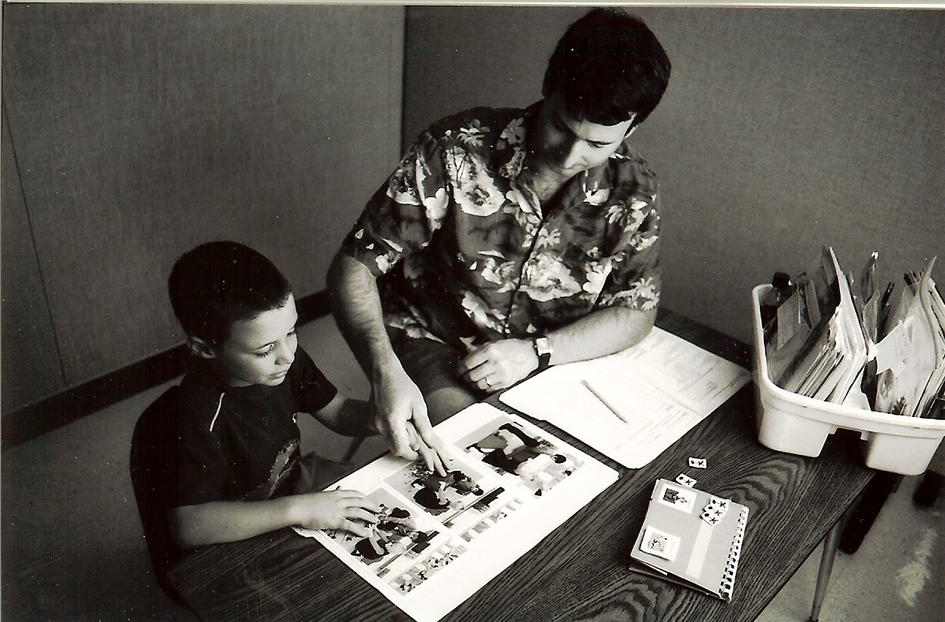
Correct Response
Discrete Trial
4

Slide 21

ABA Instructional Sequence
Instructional Cue
Student Response
Consequence (generally a reinforcer)
Pause (inter-trial interval)
This teaching sequence is used with a curriculum that has scope and sequence with developmental levels of functional skills.
Notes:
We went through this - this morning. Do NOT spend time on it.
Refer to top of pg 66

Slide 22

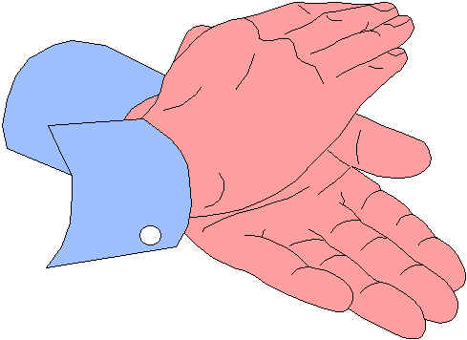
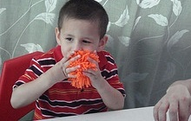
Typical DT Trial
Mass Trial (MT)
Cue - “Do X”
Response – Student does correct response
Prompt – None needed
Consequence – Reinforcer (primary + verbal praise)
“Do this”
“Clapping hands. That’s right!”
Notes:
If the child is correct the sequence will look like this.

Slide 23
Correct Response
Correct response = Big reinforcer (either direct reinforcement or token system) plus social praise
Data:
Correct response = +
Ring bell
+
MT
Note: MT = mass trial (a typical discrete trial)

Slide 24
3 Correct Responses
Move on to the next step after 3 correct responses in a row.
Ring bell Ring bell w/D 0 + + + MT
+ + + MT

Slide 25

Incorrect Response
If the student does not respond or responds incorrectly, then implement the error correction procedure.

Slide 26

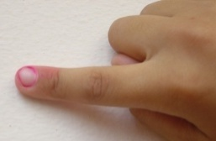
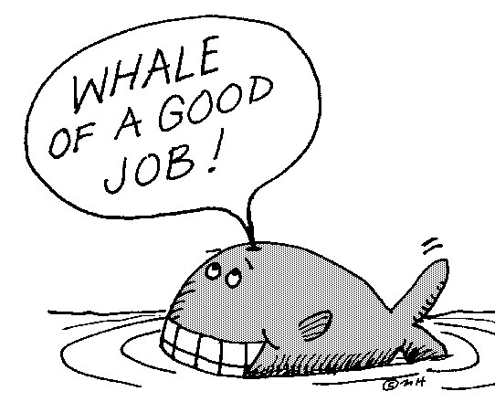
Error Correction Procedure
Stop and restart trial.
Repeat cue.
Prompt with just enough assistance to get correct response.
R+ with social praise only or very little reinforcer, (not the big R+).
Repeat trial (with big R+ available)
Notes:
Here’s the sequence.
Everyone practice with “Ring Bell”

Slide 27
Data Collection
+ = correct response
O = needed extra prompt (more than instructional cue) to respond correctly
O = did not respond or incorrect response (even though a prompt was attempted)
Notes:
Right side of folder - Page 81
Provides a sample data sheet so you can see what it will look like with daily use.

Slide 28
Incorrect Trial
Ring Bell | + | + | +
Ring Bell w/D | + | 0 |  |  |  | Student makes error

Slide 29
Error Correction Procedure
Ring Bell | + | + | +
Ring Bell w/D | + | 0 |  |  |  | Always provide a correction procedure (/) after an error (0)

Slide 30
Next Trial After Prompted Trial
Ring Bell | + | + | +
Ring Bell w/D | + | 0 | + |  |  | After prompted trial, keep position of items the same
Notes:
Let the group practice this whold sequence with “Ring Bell”

Slide 31
Reinforced Learning Trial (RLT)
If the student makes three errors in a row, then implement reinforced learning trial.
Three errors in a row
Go into reinforced learning trial
Ring bell Ring bell w/D 0 0 0 MT
+ + + MT

Slide 32
Reinforced Learning Trial
After 3 errors in a row
Give instructional cue
Provide a slight prompt (or just enough of a prompt to get correct response) just following the cue.
Reinforce with tangible and social praise
When student gets 3/3 move back to “less or no” prompt.
Notes:
Continue page 79
Look at October 4th
Talk through decisions and notations on each of the four lines.

Slide 33

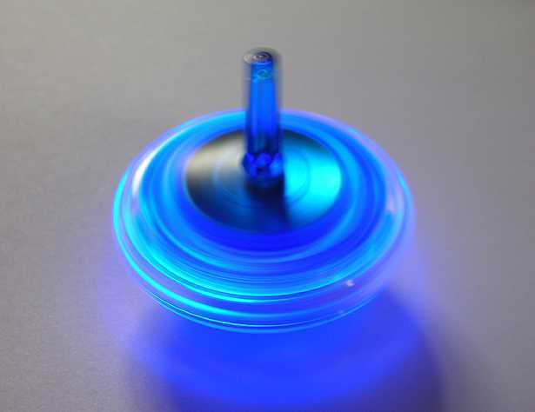
Reinforced Learning Trial
Present cue: “Match blue”
Prompt with just enough assistance for correct response
Reinforce with big reinforcer and social praise
“Blue. Good job.”
or
or
token
edible
toy

Slide 34
Physical Prompting Levels
(Note these levels on data sheet)
Tap Prompt (touching lightly to initiate or change direction of response)
Partial Physical Prompt (more than a touch/tap, not a full physical prompt, student does some part of response by themselves)
Full Physical Prompt (Student requires physical prompting throughout response)
Notes:
Whatever you add - you wil have to remove !!

Slide 35
Reinforced Learning Trial Data
Indicate RLT on data sheet.
Student will always receive a “+” on the data sheet during RLT.
Note the prompt level in the comment section.
After three trials, try lessening level of prompt or no prompt at all.

Slide 36
Reinforced Learning Trials Example 1
Ring Bell w/D | + | 0 | 0 | 0 |  | 3 error corrections- go to Reinforced Learning Trial (RLT)
Ring Bell w/D | + | + | + |  |  | RLT- Partial Physical Prompt,
Ring Bell w/D | + | + | + |  |  | RLT – Tap Prompt
Ring Bell w/D | + | + | + |  |  | No Prompt
Notes:
Just a check for understanding with the group.
If they were to pick up this data sheet - could they understand what another person covered yesterday and what they need to do instructionally today.

Slide 37
Reinforced Learning Trial Example 2
Blue w/ D 0 0 0 + + + MT/RLT(FP)
These slashes indicate the change between mass trial and reinforced learning trial
D = distractor
MT = mass trial
RLT = reinforced learning trial
FP= full prompt

Slide 38
Introduction Procedure A
Step | Presentation of stimuli | Criteria
1 | X only | 3 consecutive correct
2 | X with distractor | 3 consecutive correct
3 | Y only | 3 consecutive correct
4 | Y with distractor | 3 consecutive correct
5 | X and Y together in random order | 3 consecutive correct on both X & Y for 2 days in a row
6 | Z only | 3 consecutive correct
7 | Z with distractor | 3 consecutive correct
8 | X, Y, and Z together in random order | 3 consec. correct for Z and 3 consec. correct for X & Y for 2 days
9 | Continue adding one new item in same format until 5 items are presented in random | Criteria are the same for steps 6-8

Slide 39
X only
“Match red” “Match red” “Match red”
red
+
+
+

Slide 40
X with distractor
“Match red” “Match red” “Match red”
Red w/ distractor
+
+
+

Slide 41
Y only
“Match green” “Match green” “Match green”
Green
+
+
+

Slide 42
Y with distractor
“Match green” “Match green” “Match green”
Green w/ distractor
+
+
+

Slide 43
X and Y together in random order
(2 consecutive days)
“Match red” “Match green” “Match red”
“Match red” “Match green” “Match green”
red
+
+
+
R
Day 1
green
+
+
+

Slide 44
Z only
“Match blue” “Match blue” “Match blue”
blue
+
+
+

Slide 45
Z with distractor
“Match blue” “Match blue” “Match blue”
Blue w/ distractor
+
+
+

Slide 46
X, Y, & Z together in random order (2 consecutive days)
“Match blue” “Match red” “Match blue”
“Match green” “Match red” “Match blue”
red, green
+
+
+
R
Day 1
blue
+
+
+

Slide 47
Continue adding one new item in same format until 5 items are presented in random
yellow
+
+
+
Yellow w/ distractor
+
+
+
red, green, blue
+
+
+
Day 1
R
yellow
+
+
+
red, green blue
+
+
+
Day 2
R
yellow
+
+
+
black
+
+
+
black w/ distractor
+
+
+

Slide 48
5 items in random (2 consecutive days)
“Match yellow” “Match black”
“Match red” “Match black”
“Match black” “Match blue”
red, green, blue, yellow
+
+
+
R
Day 1
black
+
+
+

Slide 49
Introduction Procedure B
Step | Presentation of stimuli | Criteria
1 | X only | 3 consecutive correct
2 | Y only | 3 consecutive correct
3 | X and Y in random | 3 consecutive correct on both X & Y for 2 days in a row
4 | Z only | 3 consecutive correct
5 | X, Y, & Z in random | 3 consec. correct for Z and 3 consec. correct for X & Y for 2 days
6 | Continue adding 1 new concept until at least 5 concepts are taught using steps 4-5. After 5 items are taught, continue to teach new items as directed in the lesson, rotating in the new items with old items into sets of 5. | Criteria is the same as shown for steps 4-5

Slide 50
X only
“Do this” “Do this” “Do this”
Clap hands
+
+
+

Slide 51
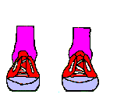
Y only
“Do this” “Do this” “Do this”
Stomp feet
+
+
+

Slide 52
X and Y in random
(2 consecutive days)
“Do this” “Do this” “Do this”
“Do this” “Do this” “Do this”
clap hands
+
+
+
R
Day 1
stomp feet
+
+
+

Slide 53
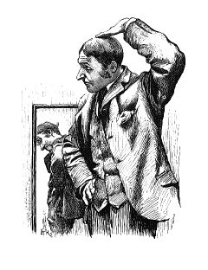
Z only
“Do this” “Do this” “Do this”
Touch head
+
+
+

Slide 54
X, Y, and Z in random
(2 consecutive days)
“Do this” “Do this” “Do this”
“Do this” “Do this” “Do this”
clap hands, stomp feet
+
+
+
R
Day 1
touch head
+
+
+

Slide 55

Continue adding one new concept and then bringing it into random
“Do this” “Do this” “Do this”
Touch feet
+
+
+

Slide 56
Random (2 consecutive days)
“Do this” “Do this” “Do this”
“Do this” “Do this” “Do this”
clap hands, stomp feet,
touch head
+
+
+
R
Day 1
touch feet
+
+
+

Slide 57
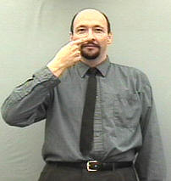
Add new concept
“Do this” “Do this” “Do this”
Touch nose
+
+
+

Slide 58
Put it in random
(2 consecutive days)
“Do this” “Do this” “Do this”
“Do this” “Do this” “Do this”
clap hands, stomp feet,
touch head, touch feet
+
+
+
R
Day 1
touch nose
+
+
+

Slide 59
Last Minute Reminders
  Intersperse attending skills throughout the session. It’s imperative that you have a student’s attention prior to giving an instructional cue. Use your reinforcer to assist in gaining attention.
  Lay items/pictures in front of child. Place item/card to be matched above the items/pictures. The student is to take the item/card from below and match it to the item/card above.
  Remember to state the name of the object or action and then give social praise. Vary your praise.

Slide 60
More reminders . . . .
  Leave the objects or pictures in the same location when implementing the correction procedure including the following trial.
Don’t disrupt the rhythm of the correction procedure to take data.
    Child makes error
    Re-present the cue and prompt for success
    Give social praise
    Immediately present cue again so child is more apt to independently respond correctly
    Take data as child is engage with reinforcer or putting token on board

Slide 61
More reminders . . .
  Don’t go into reinforced learning trial (RLT) when you are in random. If the student has made three errors in a row in random, then you need to step back and re-teach what wasn’t learned.
Fade your prompts as soon as possible in reinforced learning trial. This will increase independence and decrease the chance of prompt dependence.
End each session on a positive note and on your terms. Maintain the instructional control.

Slide 62
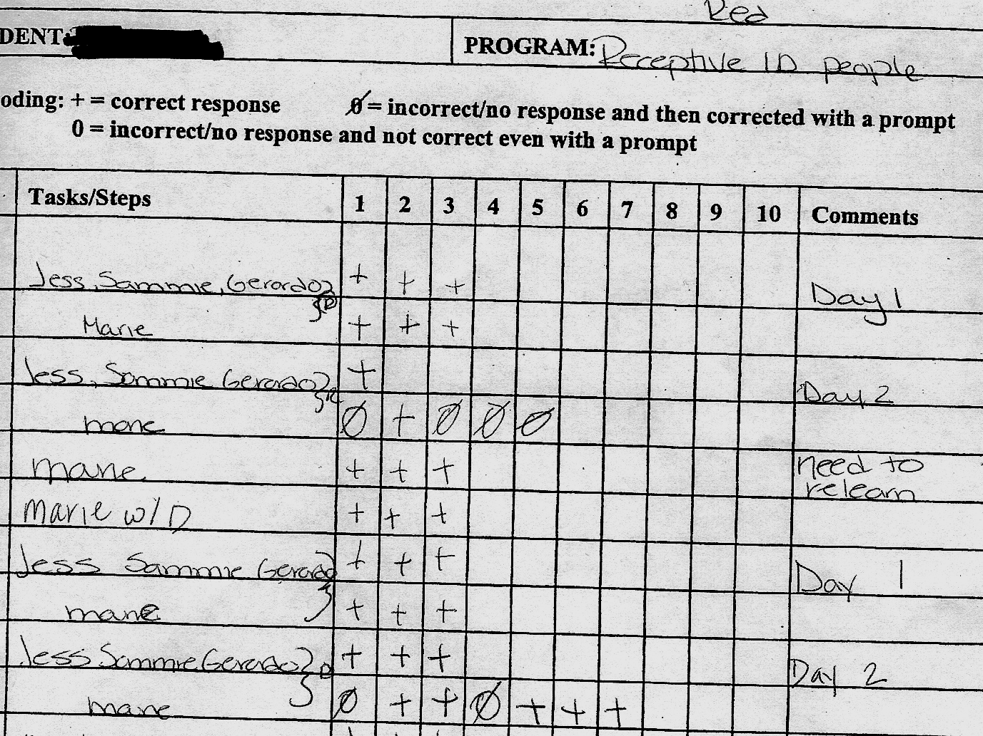
3 errors made in random
Go back and re-teach the skill and then put it back into random

Slide 63

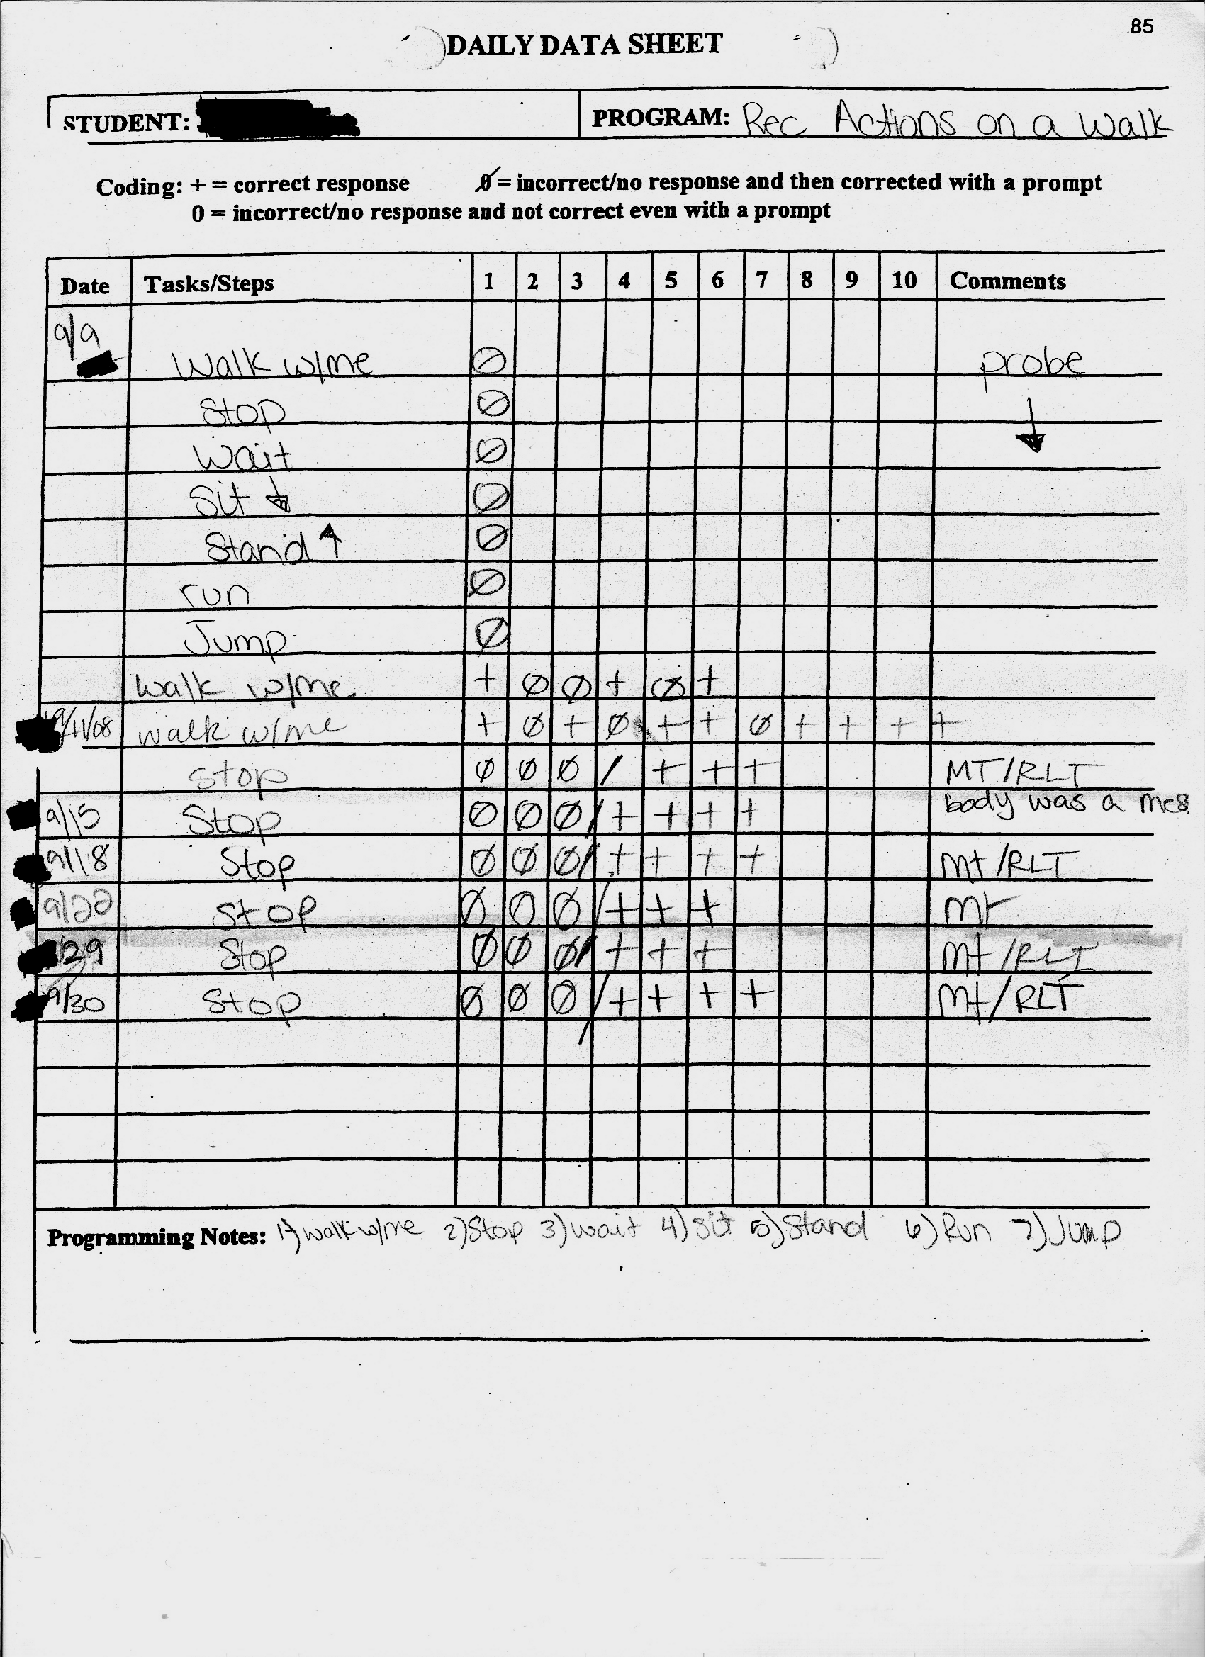

Slide 64
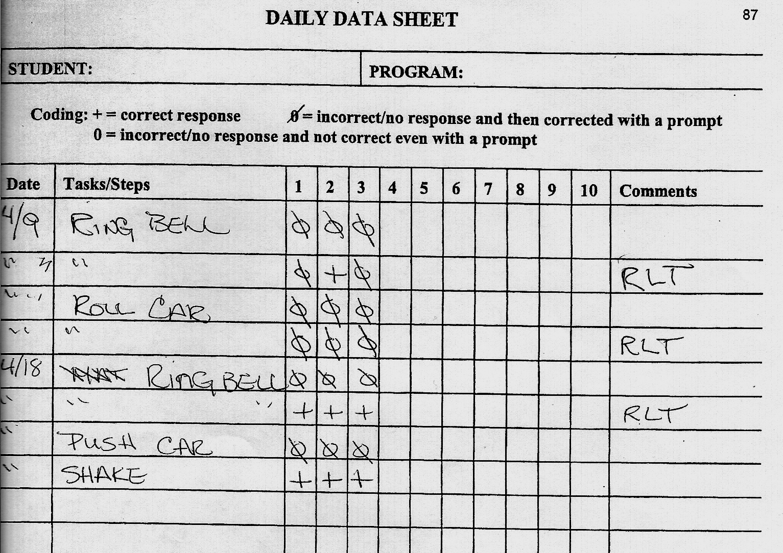
Warning

Slide 65

Place all five items on the table.
Present one item at a time as indicated in the lesson (“Match blue”). It will look like it does when you have all five items in random.
Probing can be stressful for students due to new or difficult skills being presented.
If the student makes an error, then prompt for correct response and give reinforcer or intersperse with known skills so the student is successful and stays motivated.
If a student gets all items correct on the probe, then move on to the next lesson in the program.

Slide 66
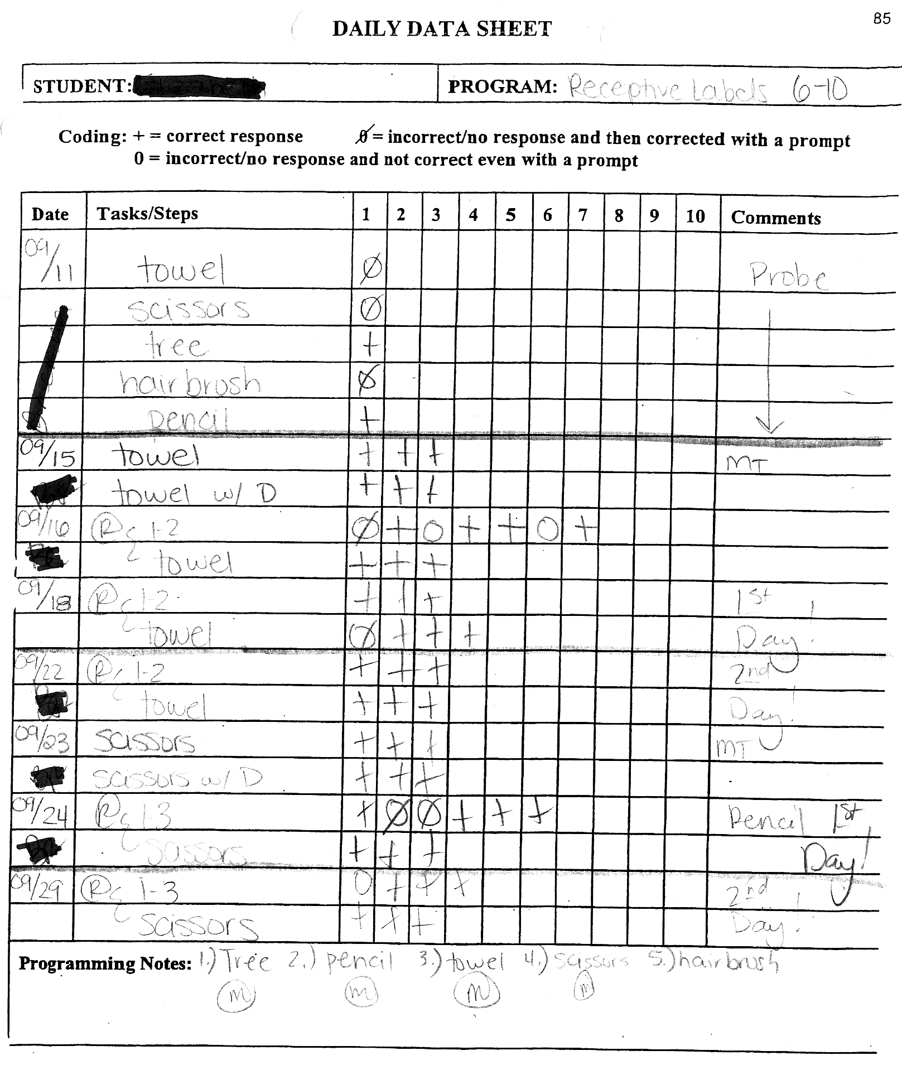
Probing:
If a student has correctly responded to some of the items during a probe, then proceed as if the student has completed those steps in the intro procedures.
Two items correct in probe
Start with first item
Put all 3 in random

Slide 67

Common Student Errors
Bringing the item from top to bottom.
  Solution: Hold the top item down so student can’t pick it up. This problem can also be fixed easily when you are presenting one item alone (X only, Y only, etc.).
Trying all my tricks.
  Solution: Be clear on the
  delivery of the cue. Make sure
  the student has hands down
  and is attending prior to the
  delivery of the cue.

Slide 68

More Student Errors
The second guesser or mind reader
  Solution: Scoot them back from
  the table. Deliver the cue. Hold
  student back if necessary to give
  them process time.
Taking the item from the same location (always to the left or always to the right).
  Solution: Drop back to one item. Do several trials with the item placed on the opposite side from the student’s preferred side.

Slide 69

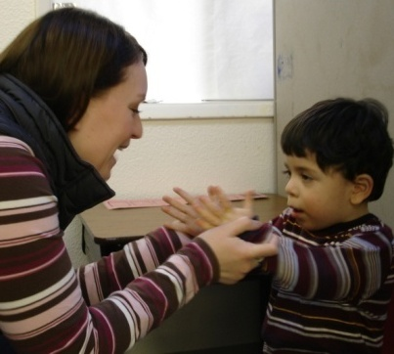

More Student Errors
A partial student response
  Solution: If it is a good effort consistent with the student’s level, then accept it as correct (give reinforcer). Emphasize the correct response by physically assisting correct skill while giving praise.
  After 3 correct responses at initial skill level, then increase your expectations for a closer approximation. Continue this process until the skills is as close to the correct response within the student ‘s capability.

Slide 70
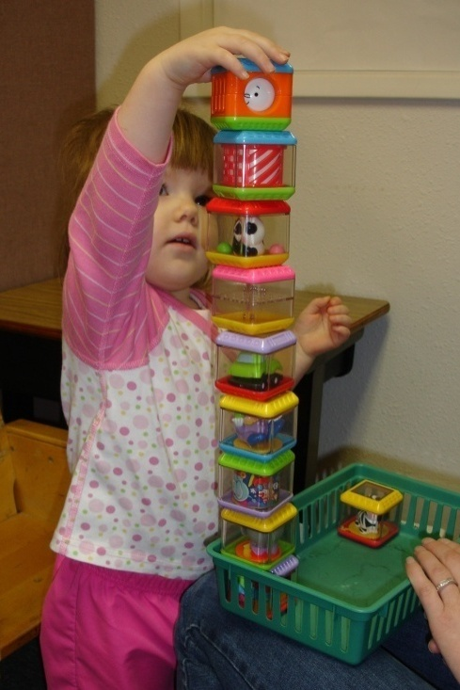
Pivotal Response Training
Enhancing Acquisition, Generalization and Maintenance of Language and Play

Slide 71
What is Pivotal Response Training?
Behavioral Intervention
Teaches Language and Play Skills
Addresses Weaknesses of DT
Creates Teachable Moments in Context
Follows ABA format
Targets “Pivotal” Skills
One Component of an Individualized Program

Slide 72
ABA Instructional Sequence
Instructional Cue
Student Response
Consequence (generally a reinforcer)
Pause (inter-trial interval)
This teaching sequence is used with a curriculum that has scope and sequence with developmental levels of functional skills.

Slide 73
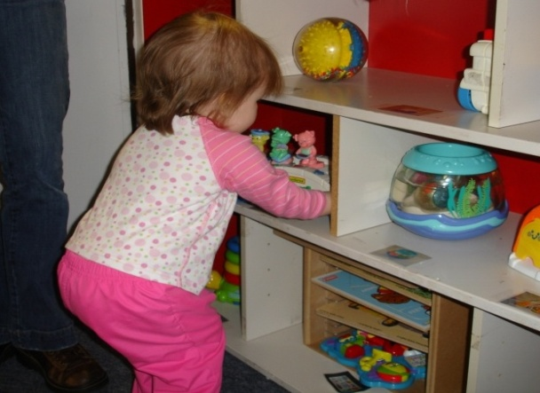
Typical PRT Sequence
Student chooses toy or activity
Adult relinquishes the toy, blocks access to the toy, or withholds the activity
Adult gives instructional cue, models the desired response, or presents the toy in an effort to get spontaneous communication
Student responds
Adult gives student access to the toy or activity

Slide 74
PRT: Some Illustrations (from initial level I)
Cue/Opportunity to Respond | Response | Consequences | Pause
-Child reaches for a toy car on a track to push it. -Teacher holding car says “car” (attempting to elicit a verbal imitation) | -Child says “go.” | -Teacher lets the child push the car on the track as a reward for requesting appropriately. | -Child continues to play with car for 5-10 seconds. . -Teacher observes level of play to prepare for the next trial.
Expressive Language Trial
PRT-LI.1
-Child reaches for a toy car on a track to spin the wheels. -Teacher holding car says “do this” and pushes the car. | -Child imitates the teacher’s action and pushes the car. | -Teacher lets the child hold the car and spin the wheels as a reward for pushing it appropriately. | -Child continues to play with car for 5-10 seconds. -Teacher observes level of play to prepare for the next trial.
Play Trial
PRT-PI.1

Slide 75
PRT Rules of Interaction
Cue (opportunity to respond)
Response
Consequence
Pause

Slide 76
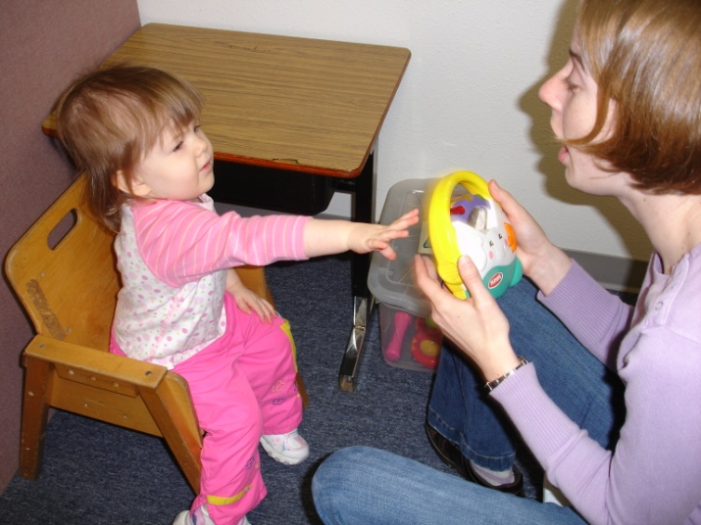
Component 3 (rules of interaction)
CUE
Example of CUE
Set-up: student reaches for a toy car
Cue: Teacher holding the car says “car”
The CUE component incorporates 3 of the Rules of interaction
Rule 1: Control is Shared
-Child chooses activity or object
-Teacher takes turns with the activity
Rule 2: Cue is Clear and Related to the Chosen Activity
-The cue/instruction should be related to the student’s chosen activity
-The cue/instruction should be clear and uninterrupted
-The student must attend to the cue
Rule 3: Intersperse Maintenance Tasks
-Maintenance Tasks are those tasks that offer a high probability of -student success
-50% of cues should be intended to elicit maintenance tasks

Slide 77
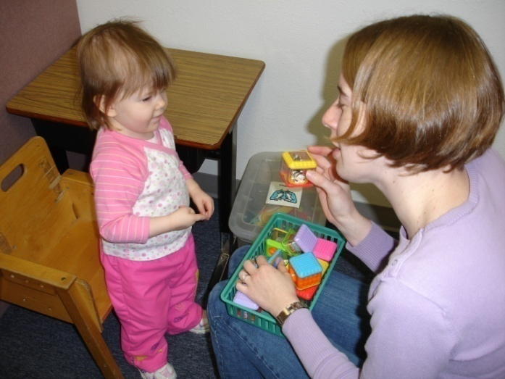
Component 3 (rules of interaction)
Response
Example of RESPONSE
The student says “go”
The RESPONSE component incorporates 2 of the Rules of interaction
Rule 4: Response may be verbal or non-verbal
-The student’s response may be expressive language or an action
Rule 5: Response is related to the activity
-The student’s response must have something to do with the chosen activity

Slide 78
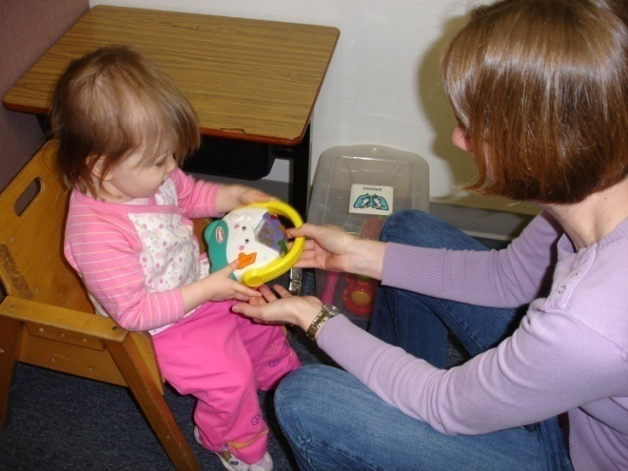
Component 3 (rules of interaction)
Consequence
Example of CONSEQUENCE
Teacher lets the child push the car on the track as a reward for requesting appropriately
The CONSEQUENCE component incorporates 3 of the Rules of interaction
Rule 6: Reinforcement is clear
-Reinforcement is immediate
-Reinforcement is clearly given to the child
-Reinforcement only follows an appropriate response
Rule 7: Reinforce Attempts
-Any response appropriate within the context of the activity should be reinforced
-Was the response a good try?
Rule 8: Reinforcement is direct
-The reinforcer is a natural consequence to the behavior being rewarded

Slide 79
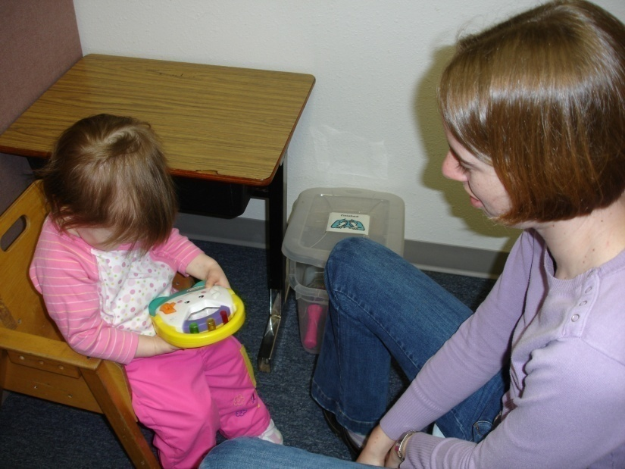
Component 3 (rules of interaction)
Pause
Example of PAUSE
-Child continues to play with car for 5-10 seconds. .
-Teacher observes level of play to prepare for the next trial.
The PAUSE component incorporates 1 of the Rules of interaction
Rule 9: Child is observed and evaluated
-Observe:
Level of motivation
Behavior
Level of language/play skills exhibited

Slide 80
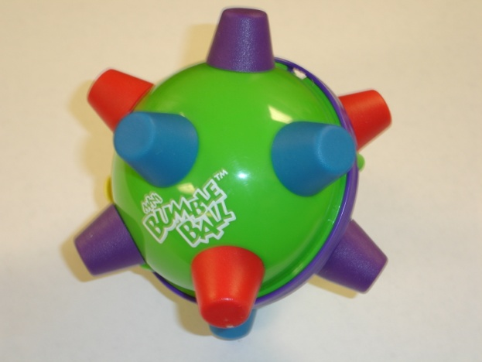
Activities/Reinforcers
Student specific
- Level 1
- Level 2
- Level 3
Observe, test, be a detective
Toys need to be in good repair
Become familiar with toys
Observe typical peers with same toys
Notes:
There are general suggestions on program sheets. BUT often the most effective reinforcer, motivator, activity, may only be determined by the student.
How do you determine this?
-Allow them to explore toys, edibles, and activities as freely as possible before beginning your first session and before the rest of your sessions.
Suggestions
Level 1-Edibles, bubbles, squishy balls, objects with interesting textures, cause and effect toys, music producing toys, some books,
Level 2-Same as above, add farm with animals, magna doodle, white board, simple games with noise, play food, puzzles
Level 3-Simple board games, building sets, dress up, kitchen, toy food, doctor set,
IMPORTANT to be familiar with toys. What does it do, how to play game, how to operate it. If you don’t know what to do you tend to do the same rote activity with the toy over and over again.

Slide 81



Interspersing Attending Skills
Eye contact
Orient to name
Sitting down (either on the floor or in chair)
Keeping hands in lap

Slide 82
Build and Maintain Rapport
Play and Interact
Observe
Attend
Notes:
Observe - It’s a way of “listening with your eyes” Cannot emphasize enough. Always looking to enhance the PRT session.
Play and Interact- Spend time at the beginning of every session (no more than 5 minutes) simply interacting with the child, offering toys to explore not contingent on any response. Exchange the toy. Be playful. Some students enjoy hand games and tickles. This is a good time for those activities. Again these interactions are not contingent on language or play.
ATTEND- You need to be present, in the moment watching the child. Attention is different from observation. During observation the teacher has an intention of using her observation to enhance some facet of the PRT session. When attending to the student, the object is just that, attending. Spend time engaged in BOTH during the PRT session.

Slide 83
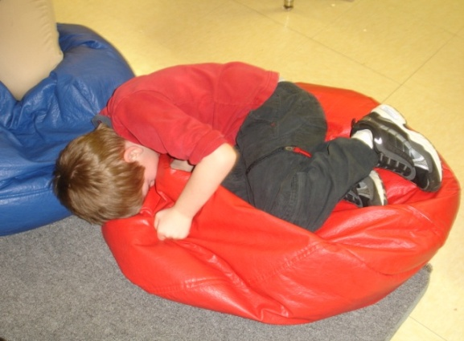
Work on Behavior Throughout the Session
Common challenging behaviors include:
- Grabbing toys and activities
- Throwing objects
- Crying
- Refusal to sit in the chair
- Lack of appropriate responding
- Redirection of the teacher by the student
- Aggression (e.g. pinching and hitting)

Slide 84
Avoid Trigger Events
-Excessive auditory stimulation
-Failure to secure student attention prior to presenting cue
-Cues that are not clear
-Infrequent/inadequate reinforcement
-Lack of motivating activities
-Environmental factors

Slide 85
Use PRT Strategy Throughout the Day
Example: Recess
Student: Stands at the bottom of the slide prepared to climb the ladder to the top.
Teacher: Prevents the student from climbing and cues “go…”
Student: Says, “go up.”
Teacher: Allows the student to climb up the ladder to the top of the slide.

Slide 86
Data Collection
Data sheet for language and play
Cue: What adult said or did to elicit a response
Response: What student said or did in response to adult’s cue
Comments: Document any prompting used and whether the student’s response was imitated (im) or spontaneous (sp)

Slide 87
PRT Data Sheet For Tracking Play or Language
Student Name: __________________________________________________
Target(s): ______________________________________________________
Staff Initials | Date | Cue | Response | Comments

Slide 88
Assess Progress Regularly
- Moving between levels in PRT is a flexible process due to day to day variability in:
-student motivation
-ability to perform tasks
-student stress level
- Students typically move back and forth from one level to the next before finally settling in at the higher level

Slide 89
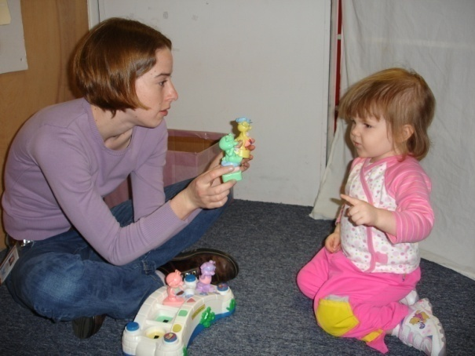
PRT Takes Patience & Practice!
Learn by doing
PRT looks easy…but it isn’t at first
Anxiety is to be expected…but will go away in time
Ask for feedback
Video tape your sessions
We all learn from modeling: Watch others

Slide 90
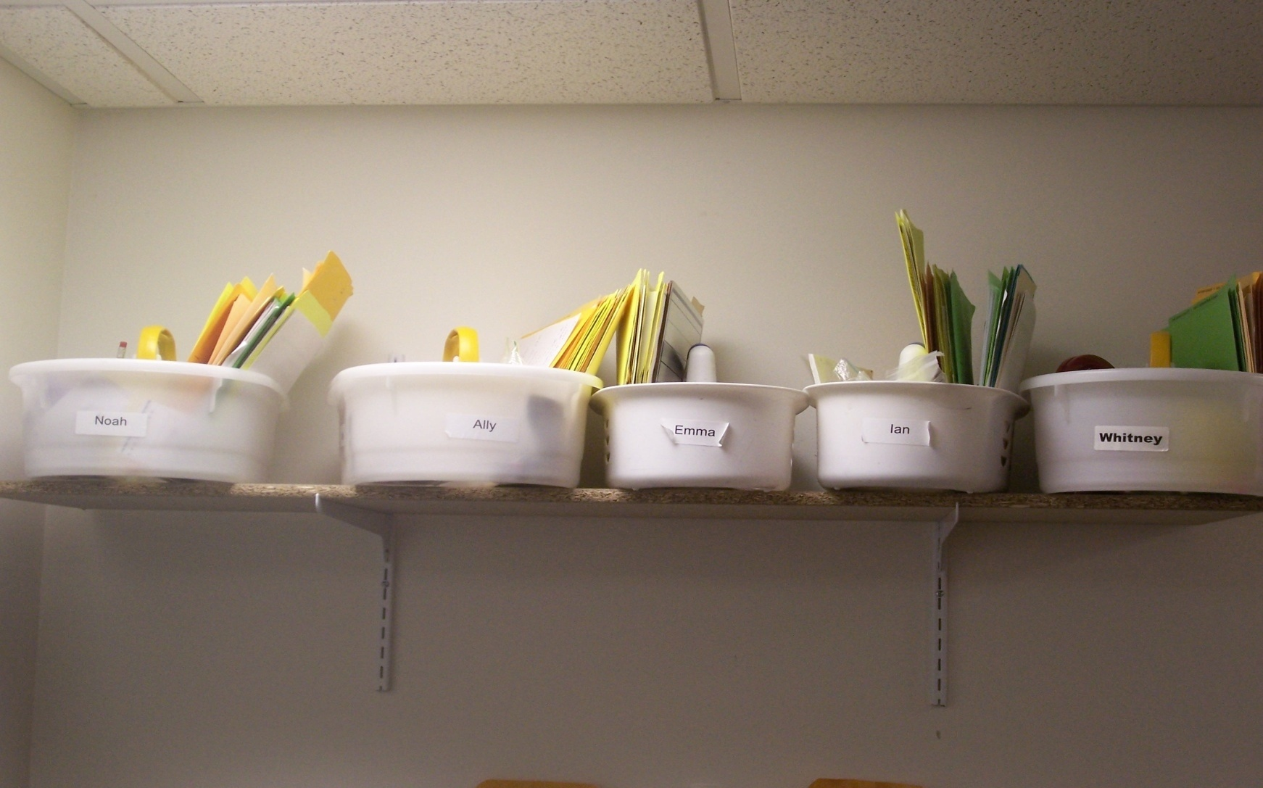
Correct Response
Getting Organized
24
4

Slide 91
Setting Up the Program
Fill out The Learning Profile
Arrange the physical space(s), visual supports, and create a schedule including 1:1 time
Based on information in the Learning Profile create a “bin” containing program folders, materials and reinforcers (DT, PRT, FR)
Begin running programs and taking data to establish a baseline, adjust programs
27

Slide 92
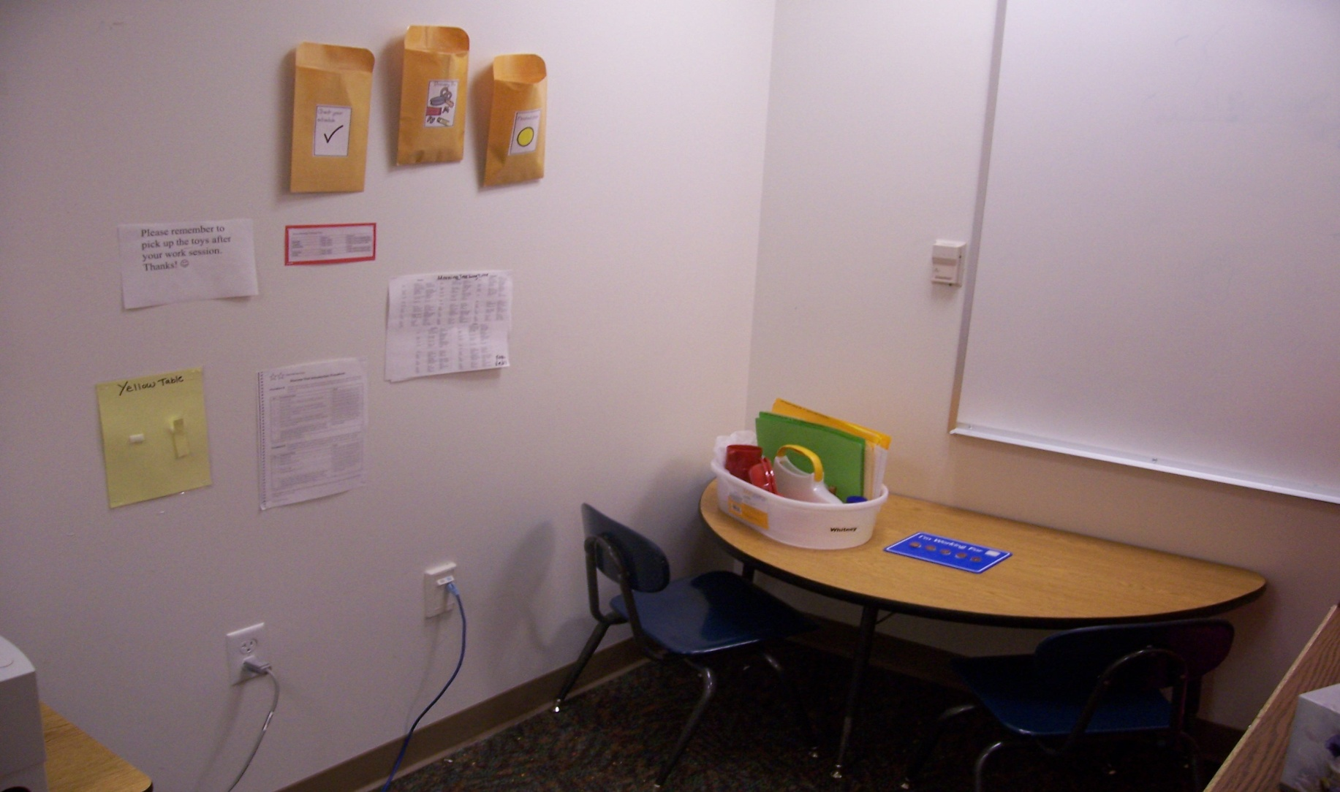
Example DT Area with Student “Bin,”
Token Board & Reinforcers
10

Slide 93
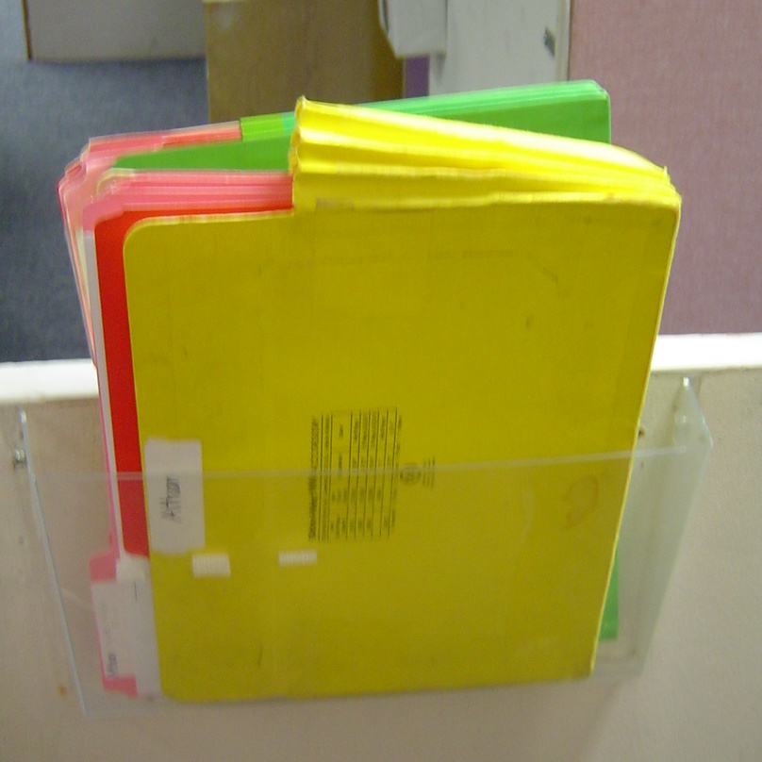
Student Program Folders
Folders are color coded for each of the curriculum areas.
Each work station can be equipped with pocket files to hold student lesson folders.
7

Slide 94
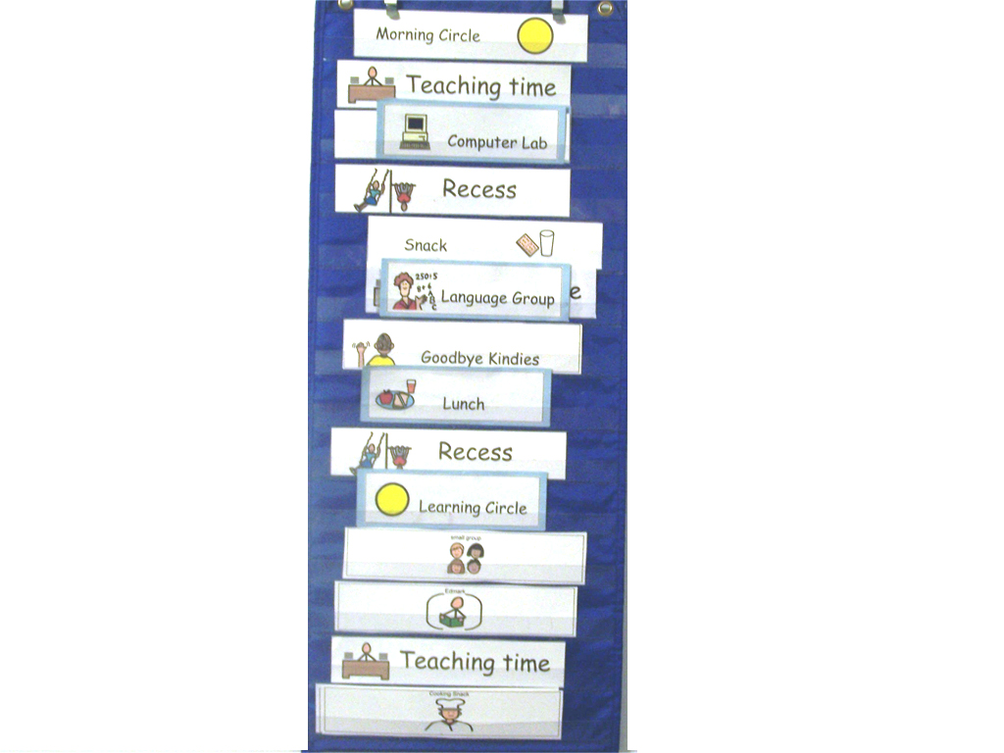
Overall Daily Schedule
(DT/PRT are done during Teaching Time)
8

Slide 95
Text
95

